Slide 1






Bootcamp
Daily Meetings
Session 7
Jeans Hernández
14/03/2024

Slide 2


Desarrollo Web Full Stack -
Avanzado
Módulo 1. Welcome / Famous People in IT
Módulo 2. Jobs in IT
Módulo 3. The World of Information Technology IT (1)
Módulo 4. The World of Information Technology IT (2)
Módulo 5. Roles and Tasks in an IT Company
Módulo 6. Virtual calls
Módulo 7. Daily meetings
Módulo 8. CV (Curriculum Vitae) (1)

Slide 3
Table of contents
1
Daily Meetings
2
Reading
3
Role play

Slide 4

Objectives:
1
2
3
To describe strategies to use when having daily meetings
To practice common expressions in the context IT area
To role-play meetings with partners to simulate real contexts situations

Slide 5
LET’S PLAY!

Slide 6

It’s your turn!
Think about a virtual call situation. Make the dialogue.
Take in mind the following aspects:
Who are the speakers? (Choose three roles in an IT company. E.g. CTO, game designers, software developers, project managers, programmers, market team, etc.)
What is the purpose of the meeting?
What communication issue are they presenting and how they solve it?
Open and close the meeting politely

Slide 7
Daily meeting
A daily meeting, often referred to as a "daily stand-up" or "daily scrum," is a short, time-boxed meeting in agile methodologies, particularly in Scrum, where team members quickly align on their progress, plans, and any obstacles they may be facing. These meetings typically occur at the same time and place every day and are crucial for keeping the team synchronized and focused on achieving their goals.

Slide 8
Here's how a daily meeting typically works
Time-boxed: Daily meetings are short and time-boxed, usually lasting around 15 minutes. This ensures that discussions remain focused and efficient.
Stand-up Format: Team members stand up during the meeting to encourage brevity and keep the meeting short. This practice helps prevent the meeting from becoming too long or unfocused.
Three Questions: Each team member answers three standard questions:
What did I accomplish yesterday?
What will I do today?
Are there any obstacles or impediments blocking my progress?

Slide 9
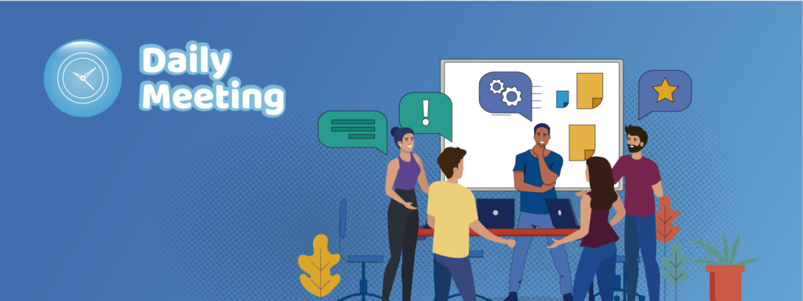
Here's how a daily meeting typically works
Focus on Collaboration: Daily meetings are not for detailed discussions or problem-solving. Instead, they serve as a way for team members to update each other quickly and identify any issues that need further attention.
Opportunity for Alignment: Daily meetings help ensure that everyone on the team is aware of what others are working on and can identify any dependencies or overlaps in tasks.

Slide 10
Software development methodologies
Software development methodologies always start from a theoretical component and when used by work teams lead to the use of a set of techniques and methods that will ultimately determine the general and specific tasks that should be performed to achieve an objective.
There are two major classifications of software development methodologies that are generally grouped as traditional frameworks or agile frameworks.

Slide 11
Agile frameworks/memethodologies
Agile frameworks or agile methodologies for software development are born as another option to address projects where it is not possible to have a complete detail of the requirements and their estimates in the first phase of the project or where it is necessary to make adaptability processes throughout the software development process.
(Maida and Pacienzia, 2015).

Slide 12
SCRUM
Scrum, on the other hand, is an agile framework for developing, delivering, and sustaining complex products. It is based on principles of transparency, inspection, and adaptation. Scrum emphasizes iterative development, with small, cross-functional teams working in short cycles called "sprints" to deliver incremental improvements to the product.
These meetings can occur in any department or team and can vary greatly in purpose, structure, and duration.

Slide 13
Key elements of Scrum include
Sprint Planning: At the beginning of each sprint, the team plans the work to be done and selects the items from the product backlog that they will complete during the sprint.
Daily Stand-up: As mentioned earlier, the daily stand-up is a brief meeting where team members update each other on their progress, plans, and any obstacles they are facing.
Sprint Review: At the end of each sprint, the team demonstrates the work completed during the sprint and gathers feedback from stakeholders.

Slide 14
Key elements of Scrum include
Sprint Retrospective: After the sprint review, the team holds a retrospective meeting to reflect on what went well during the sprint, what could be improved, and any actions they will take to improve their process in the next sprint.
Product Backlog: The product backlog is a prioritized list of features, enhancements, and fixes that need to be implemented in the product. It is continuously refined and updated based on feedback from stakeholders.

Slide 15
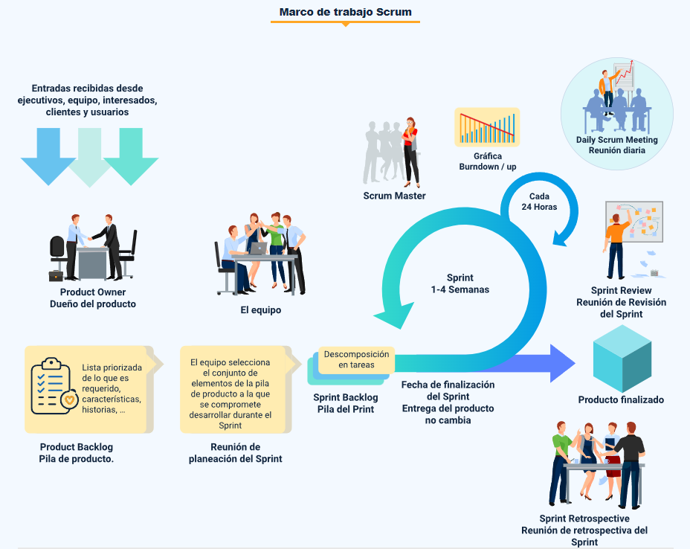

Slide 16
Here's a table summarizing the key differences
Feature | Daily Meeting | Scrum
Purpose | Varies depending on the team | Inspect progress and adapt plan within Scrum framework
Frequency | Every day | Every day within a Scrum project
Duration | Can vary | Typically, 15 minutes
Who attends | Can involve anyone | Scrum Team (Product Owner, Scrum

Slide 17
Team-Specific Language:
Project Management:
"Deliverables" - The outputs of a project stage.
"Roadmap" - A high-level plan for project execution.
"Resource allocation" - Assigning people and equipment to tasks.
"Scope creep" - Project expansion beyond its initial definition.
Marketing:
"Target audience" - The intended recipients of a marketing campaign.
"Brand awareness" - Public recognition of a company or product.
"SEO (Search Engine Optimization)" - Practices to improve website ranking.
"Conversion rate" - The percentage of visitors taking a desired action (e.g., purchase).

Slide 18
Team-Specific Language:
Sales:
"Lead generation" - Identifying potential customers.
"Sales funnel" - The stages a prospect goes through before buying.
"Closing the deal" - Securing a sale from a potential customer.
"Upselling" - Convincing a customer to buy a more expensive option.
Additionally:
Acronyms: Be mindful of acronyms specific to the team's domain (e.g., API in IT, KPI in Marketing).
Technical Jargon: If unfamiliar terms arise, politely ask for clarification.
Action Items: Look for phrases like "action item" or "to-do" followed by tasks assigned to individuals or teams.

Slide 19
Phrases and expressions frequently used
Introduction and Greeting:
"Good [morning/afternoon/evening], everyone. Thank you for joining us today"
"Welcome to today's meeting."
"I'd like to extend a warm welcome to all attendees."
"Thank you all for being here today."
Setting the Agenda:
"Let's start by going through the agenda for today's meeting."
"We have several items to cover, including..."
"Our main objectives for this meeting are..."
"Please feel free to add any additional items to the agenda."

Slide 20
Phrases and expressions frequently used
Clarifying Objectives:
"Our goal today is to..."
"We aim to achieve..."
"The purpose of this meeting is to..."
"By the end of this meeting, we should have..."
Seeking Clarification:
"Can you elaborate on that a bit?"
"Just to make sure I understand..."
"Does anyone have any questions so far?"

Slide 21
Phrases and expressions frequently used
Decision-Making:
"I propose we..."
"It seems like we're in agreement on..."
"Shall we proceed with this course of action?"
"Does anyone have any objections to moving forward with this plan?"
"Let's put it to a vote."
Assigning Action Items:
"Who would like to take responsibility for..."
"Let's assign tasks to ensure follow-up."
"We need volunteers for the following action items."
"Please make a note of your responsibilities."

Slide 22
Phrases and expressions frequently used
Summarizing and Synthesizing:
"So, just to summarize..."
"In essence, what we're saying is..."
"To recap, we've discussed..."
"Let's distill our key takeaways from this discussion."
Closing the Meeting:
"Thank you all for your valuable contributions."
"Our next steps are..."
"The meeting is now concluded."
"Let's summarize the key takeaways from today's meeting."
"Here are the next steps and action items for everyone."

Slide 23


Reading
Read the scripts and role-play them with your classmates.
Watch your pronunciation and discuss unknown words.
Team up and create your own script.
READ HERE

Slide 24
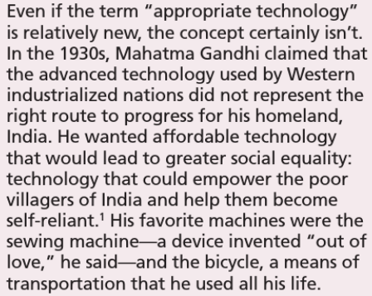
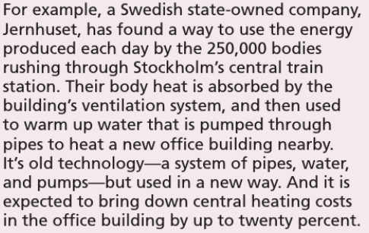
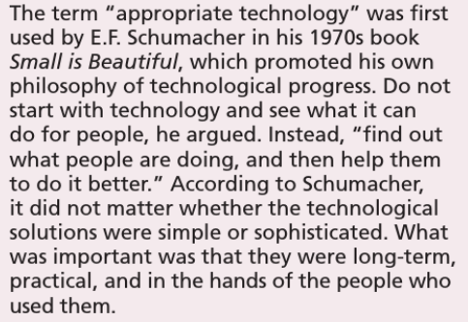
2
3
1

Slide 25
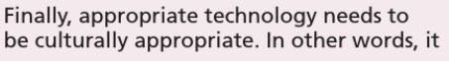
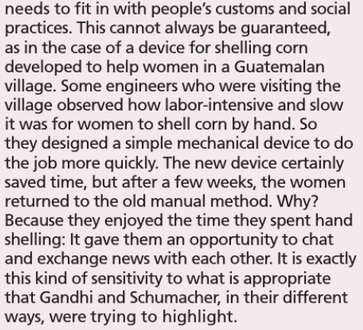
4

Slide 26
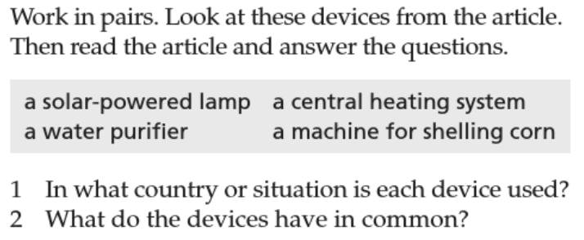
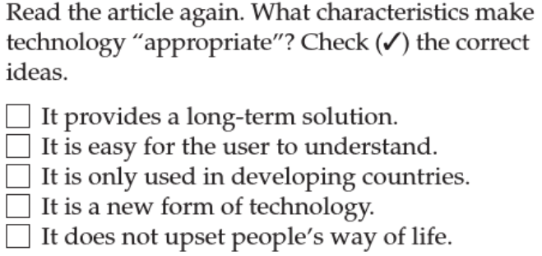

Slide 27
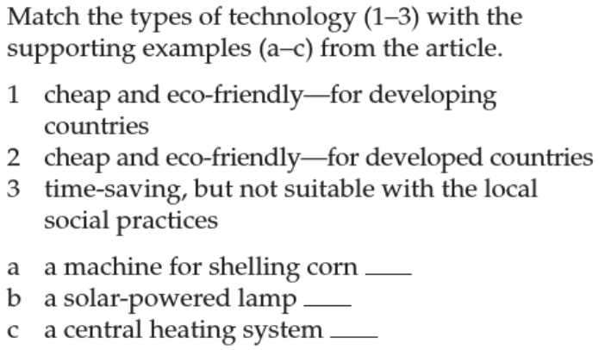

Slide 28
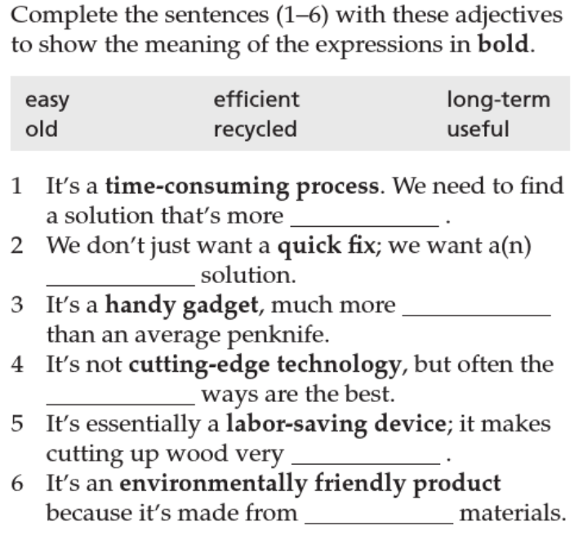

Slide 29


